Slide 1


SlugGuard - Expert System for
AI-Driven Slugging Detection
Guided research (CSCI 6917)
FInal presentation
Dursun Dashdamirov
08.08.2024

Slide 2
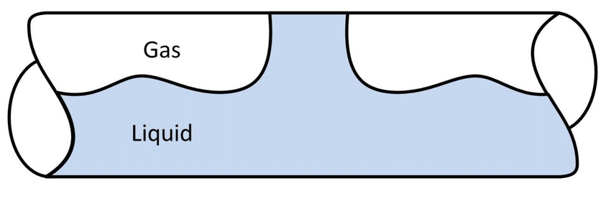
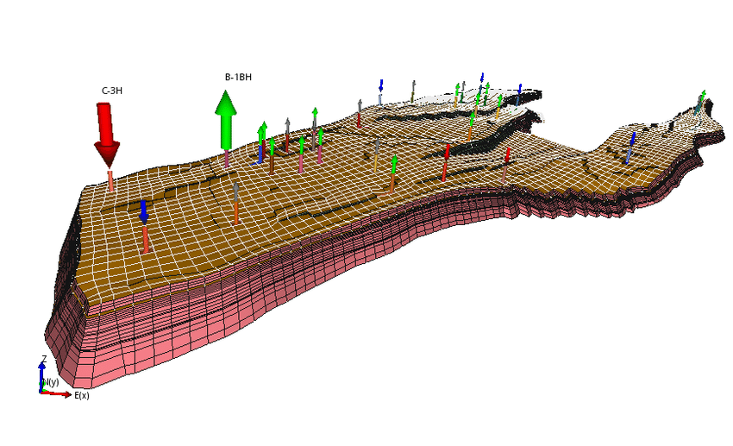
Project Objective
Flow which can occur when liquid (oil and water) and gas phases alternate in wellbore/pipeline which causes several operational issues.
Currently, petroleum engineers dedicated to the platform are monitoring the crucial parameters to detect slugging in wells. This process holds immense potential to be automated since the rules for detection is well-known.
Past trials in data driven detection(mainly deep learning approaches) had data limitation problems [2] due to:
1. There is limited data to be trained on in the early time of the fields.
2. It is not a common approach to create a labeled dataset of detected cases.
Notes:
This alternating flow can cause significant fluctuations in pressure and flow rates, leading to operational challenges. If not addressed promptly, slugging can result in severe vibrations and potential damage to equipment, increased wear and tear on pipelines, and inefficiencies in production. Moreover, it can cause safety hazards, such as gas surges, which can be dangerous for personnel and infrastructure. Addressing slugging in a timely manner is crucial to maintaining the integrity of the well and ensuring efficient and safe production operations.

Slide 3
Heilmeier Questions
What are you going to do?
I will develop SlugGuard, an alert system for detecting slugging in wells and notifying engineers.
2. How is it done today? Current Limitations?
Engineer monitoring or use of neural networks which suffer from insufficient labeled data.
What is your new idea?
I propose a knowledge-based detection system using domain expertise and real-world data.
Who will benefit from your work? Why?
Petroleum engineers and the oil and gas industry will benefit from automated, timely slugging detection.
What risks do you anticipate?
Data availability and the need for high accuracy were among potential risks.
Out of pocket costs? Complete within 11 weeks?
No costs were registered, and the project was completed within 11 weeks.

Slide 4
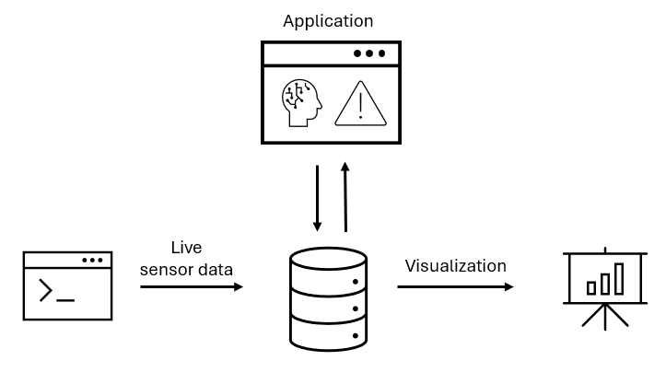
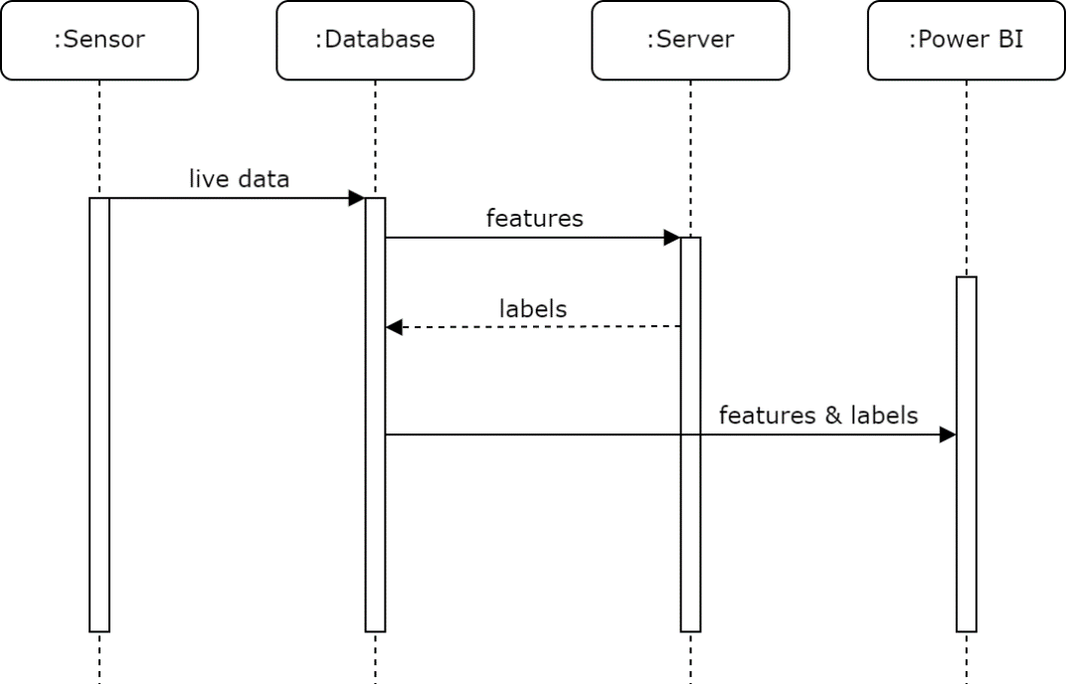

Technical Approach
Proposed overall architecture
Sequence diagram
Expert system
Alert system
Notes:
The live data sent by sensor is collected in the database. Main application has “cron” logic which reads data from pre-defined time intervals throughout the day. This data(e.g features) are analyzed and labels for each row are created. This labels are written back to the database which can be used for visualization and analytics purposes.

Slide 5



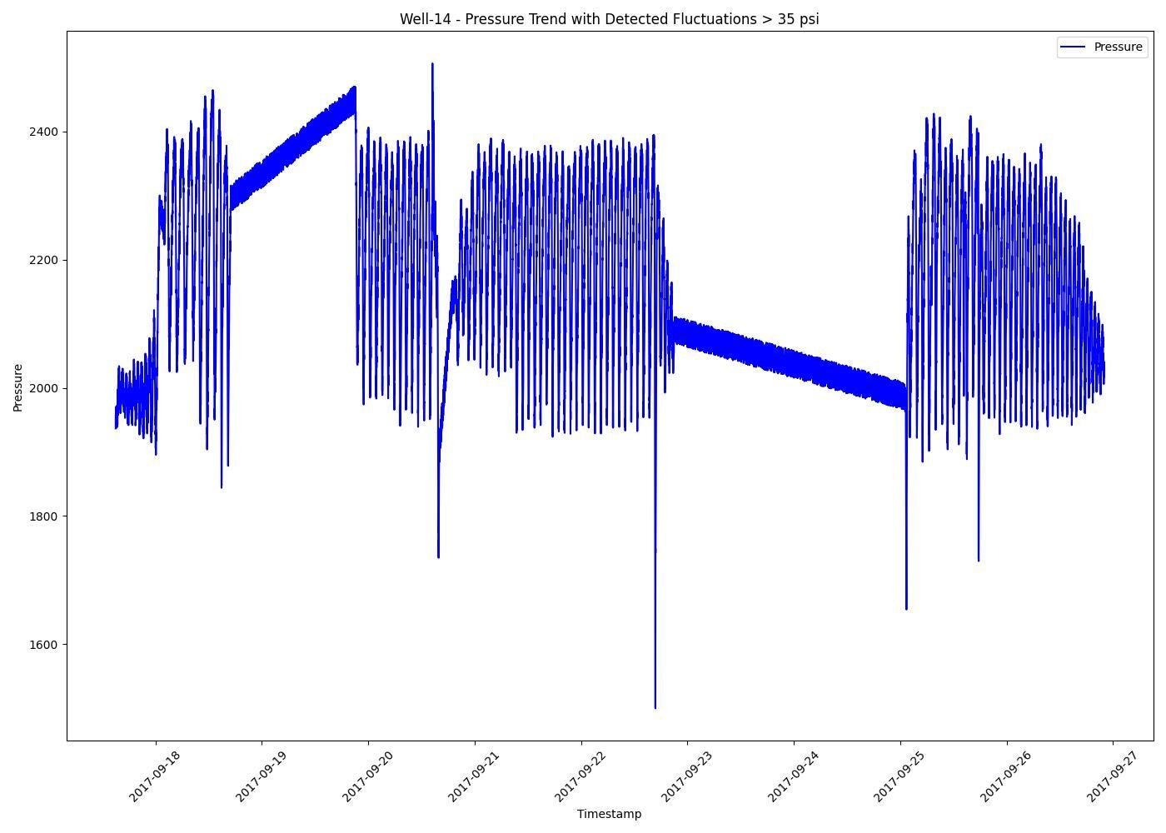
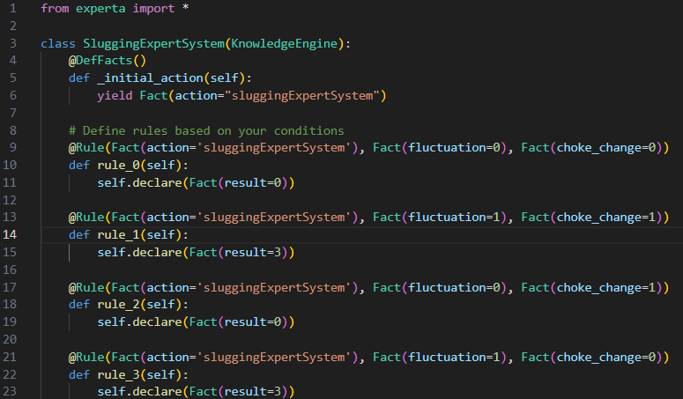
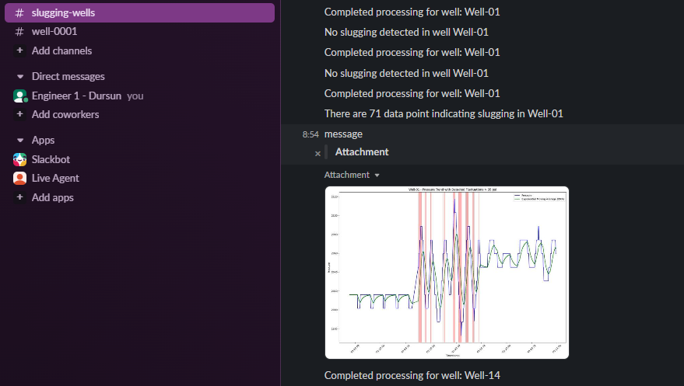
Technical Approach
Key steps in research
Notification system
and additional features
Data preparation
SlugGuard Agent
Finding the data
Addition of new features
Feature engineering
Loading data to database
Collection of rules from engineers
Modelling of rules in experta [3]
Applying rules to detect slugging
Timely notification of engineers via Slack
Sending case details and visualizations
Running code” simultaneously
Several modifiable parameters (window size, fluctuation threshold, how often to analyze etc.)
Real data from oil field
Synthetic data
(interpolation + noise)

Slide 6
Technical Approach
What is innovative about your research?
Reduction of man-hours (2 hours daily for each engineer)
Proven application of expert system in engineering sphere
Labeling time series data with expert knowledge which can be used for probabilistic AI
Utilization and creation of expert-curated dataset

Slide 7
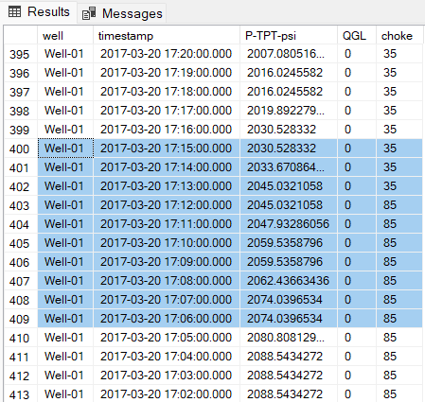
Results
Current structure of rules
After each new period reading, algorithm updates the row in the database with classification results:
Data
normal
No
normal
fluctuation
Yes
Yes
Choke change
normal
No
Yes
Gas lift change
No
Immediate action needed
Notes:
Rule based system consists of 3 main logic checks. First, each time interval is checked for fluctuations in pressure profile. If the well pressure is fluctuating, the changes in choke and gas lift are evaluated. If there have been no changes, it means this is natural behavior of the well and not caused by operational changes. This case triggers the alert system and sends a special message to engineer.

Slide 8
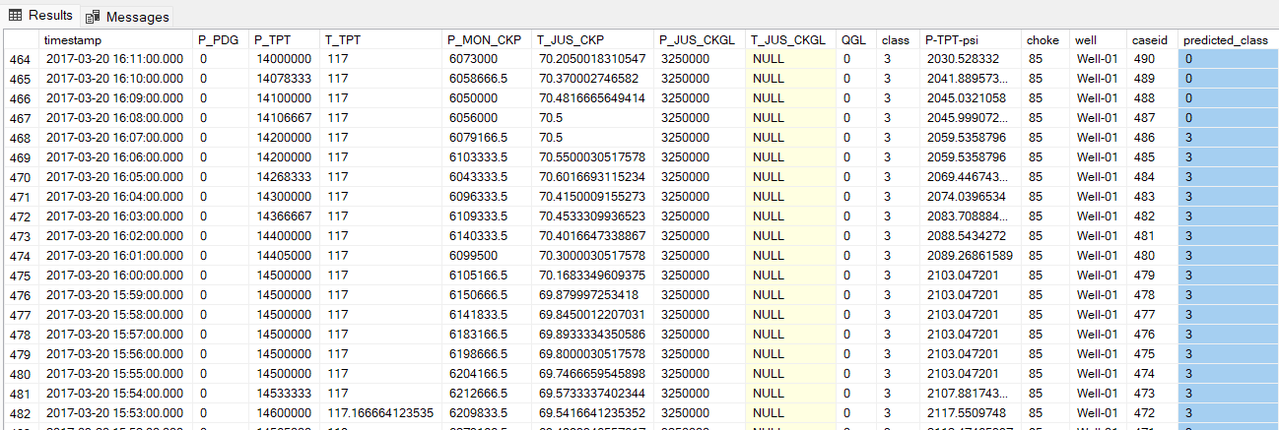
Results
Labeling process
After each new period reading, algorithm updates the row in the database with classification results:
0 – normal
3 - slugging

Slide 9
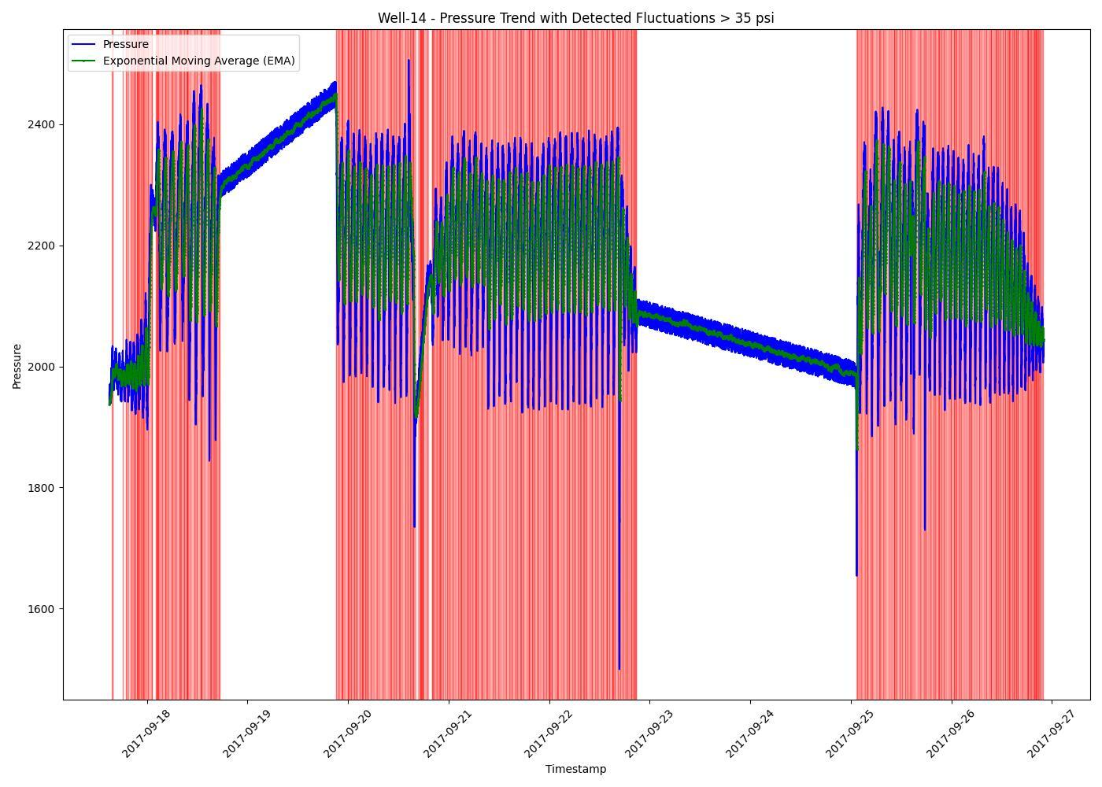


Results
The algorithm has been tested on a validation dataset with 10,000+ rows, accuracy and effectiveness are assessed by 3 metrics:
~1 min*
Average time needed for detection
84%
Pointwise accuracy on validation data,
$$accuracy_{1}=\frac{correctly classified points}{total number of data points}$$
100%
Case wise accuracy on validation data,
$$accuracy_{2}=\frac{correctly classified cases}{total number of cases}$$
*This is an average estimation. For current set up (reading 10 days worth of data with one minute frequency) needs about 30 sec, picture upload time to Slack may vary based on speed of internet

Slide 10
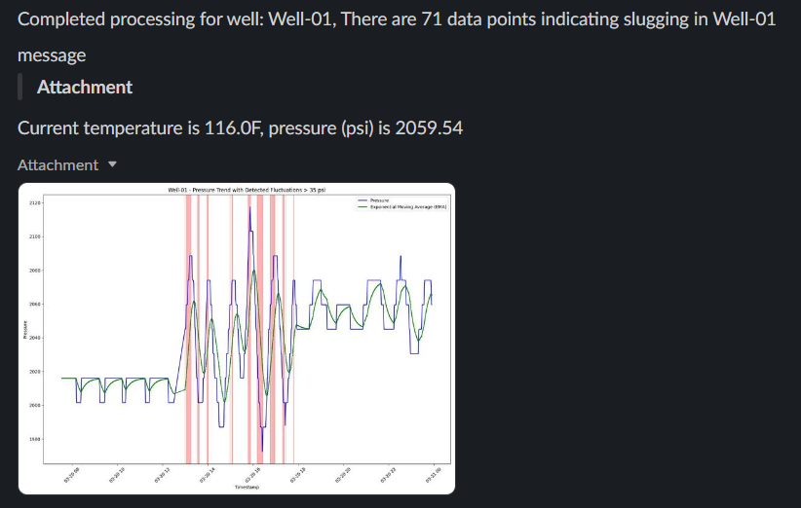
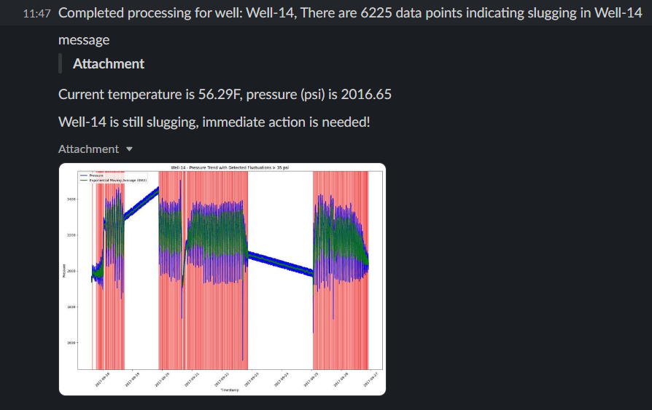


Results
Notification to users with current operation conditions

Slide 11

Conclusion
This project demonstrated how Expert System in artificial intelligence can be applied on real-world engineering problems. This project architecture and codes can easily be adopted and utilized by companies with minor modifications.
Proven application of expert system in engineering sphere
Reduction of man-hours (2 hour daily for each engineer)
Labeling time series data with expert knowledge that can be used for probabilistic AI training
Utilization and creation of expert-curated dataset
Future work
For even more smooth usage, the project can be extended to include
Development of more unified rules for slugging (currently it is company specific)
Faster way to interact with database?
More interaction capabilities with Agent

Slide 12
Future work
For even more smooth usage, the project can be extended to include
Development of more unified rules for slugging (currently it is company specific)
Faster way to interact with database?
More interaction capabilities with Agent

Slide 13
References
Cover image: https://f-e-t.com/product/gas-guard/
Dinesh Dabholkar, Rawat, D., Sunil Manikani and Abraham, D. (2023). Slug Forecasting and Production Optimization Using Deep Learning. doi: https://doi.org/10.4043/32300-ms.
Experta library: https://pypi.org/project/experta/

